Slide 1
Delivery of TRAIN project
288055952
28.02.2024
Michael Zigldrum

Slide 2
Project Plan
Challenges
CRs & other Changes
Live Demo & Artefacts
Open Topics

Slide 3
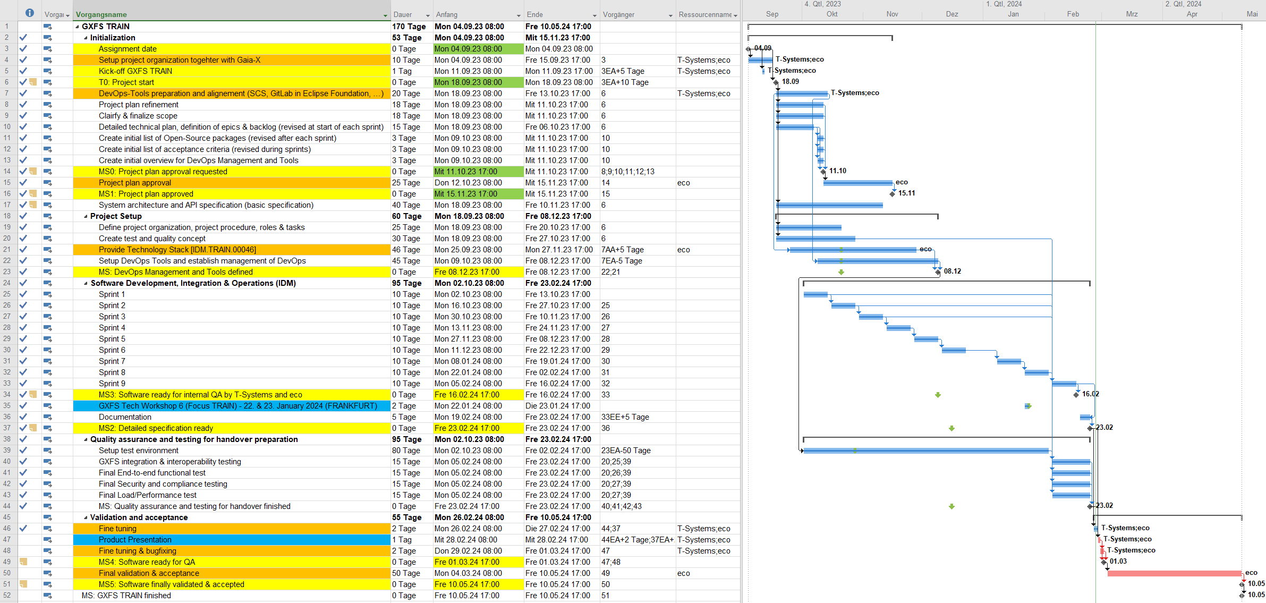

Slide 4


Project Plan
Assemble a Team
Start with basic functionality
Improve in every sprint
Verify Alignment with Requirements
Repeat from Step 3

Slide 5
Project Plan
Understand & Discuss Requirements
Build Acceptance Criteria
Get settled into workflow with gitlab
Refine Requirements with PO/Eco
Discuss & Align CRs
Assemble a Team
Start with basic functionality
Improve in every sprint
Verify Alignment with Requirements
Repeat from Step 3

Slide 6
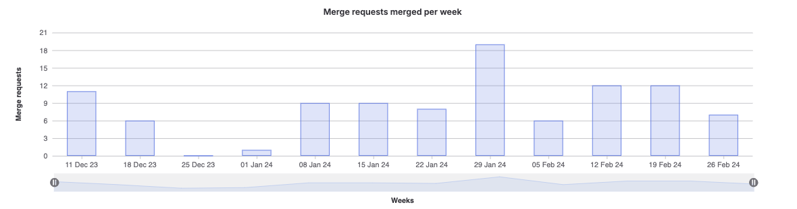
Project Plan - Statistics
1 Workshop | 6 Dev Team Members | 9 Sprints | 126 Issues | 181 Story Points

Slide 7
Challenges
Infrastructure
Specification
Third Party

Slide 8
Challenges
Infrastructure
Specification
Third Party
Committer rights
Wiki is pretty much unusable for teams
No CI/CD on forked projects
Updating forks does not work properly
Repositories:
Harbor repo with separate user creds
Gitlab repositories are switched off (npm, maven, docker)
Unclear what we are allowed/supposed to do, and what is handled by eco on kube clusters
Deployment difficulties due to gitlab rate limiting (no tokens available)

Slide 9
Challenges
Infrastructure
Specification
Third Party
Conflicting/Incorrect statements in specification:
Sequence Diagram Page 16 in „Trust Management Infrastructure for GX.pdf“
Tspa does not create DiD, DiD Document or well-known did
Order of Operations is wrong
Requirement IDM.TRAIN.00068 – Requiring functionality not covered by TRAIN concept
Vague requirements e.g.:
„Support different service types“
It is nowhere stated which dids must be supported with a well-known check
Integration requirements without a direction (i.e.: Component X must use component Y)

Slide 10
Challenges
Infrastructure
Specification
Third Party
Inclusion of Third party products with problematic Licenses (Knot DNS)
Request for lists of third-party libraries before project start
Better to request automatic license reporting on repos
Request a list towards the end/at the end, or use the automatic reports
Requirement to base implementation on specific projects
i.e.: LightTest Zonemanager
Difficult to remove sqlite, and other features that are not needed for TRAIN

Slide 11
CRs & other Changes
JWT Token Usage CR
Move from APIKey to JWT based Auth
Allow generic OIDC Issuer
TSA Signer Usage CR
Enable usage of the TSA Signer Component
Make the usage configurable

Slide 12
CRs & other Changes
KNOT DNS
Core DNS
Trusted Content Resolving
No Istio
Removed KNOT DNS because of incompatible Licenses
CoreDNS is related to Kubernetes Deployment so not relevant to TRAIN
Some Requirements required functionality incompatible with the broader TRAIN Spec
Istio deployment was not ready at start of project, so we focused on Nginx in accordance with Steffen as PO

Slide 13
Live Demo & Artefacts

Slide 14

Non-code Artefacts
Documentation
Install, Admin & Usage Docs
Architecture Docs
Demonstration Runbook
FAQ Page (Basic version)
GDPR Documentation
Security Documentation
BDD Test Reports
License Reports
Acceptance Criteria List

Slide 15

Open Topics – Issues for QoL
Extra jenkins Domain
Refactoring
Second deployment instance
Simplify key rollover for DNS
Updating DNSJava after Fixes are implemented

Slide 16
Open Topics – Integration
Integration of TSA Signer
Functionality to use TSA is done.
TSA Signer Signatures are not valid/correct
Integration of TRAIN with Notary
We provided all documentation about TRAIN apis and usage.
Remaining are requests for OCM/PCM documentation which is out of scope for TRAIN

